Slide 1





Realistic Laue cameras
- using advanced McStas keywords and a look at polycrystal-samples

Slide 2


Agenda
Polycrystals - how to describe them?
Combining a powder sample with a Single Crystal
Tricking the Single_crystal…
A reminder of the GROUP and SPLIT keywords
The dangerous JUMP keyword
A at look at the TOPAZ and SENJU instruments

Slide 3
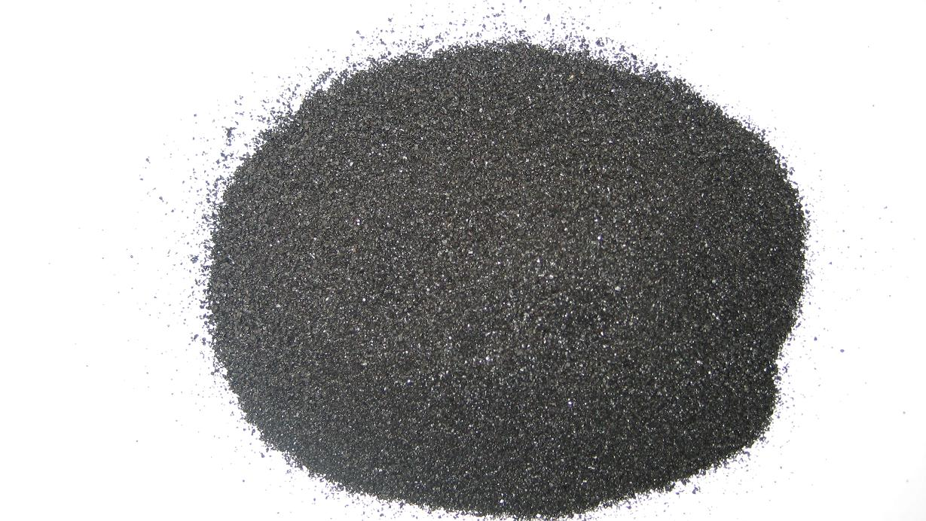
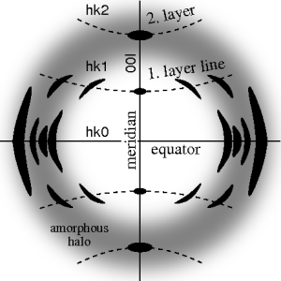
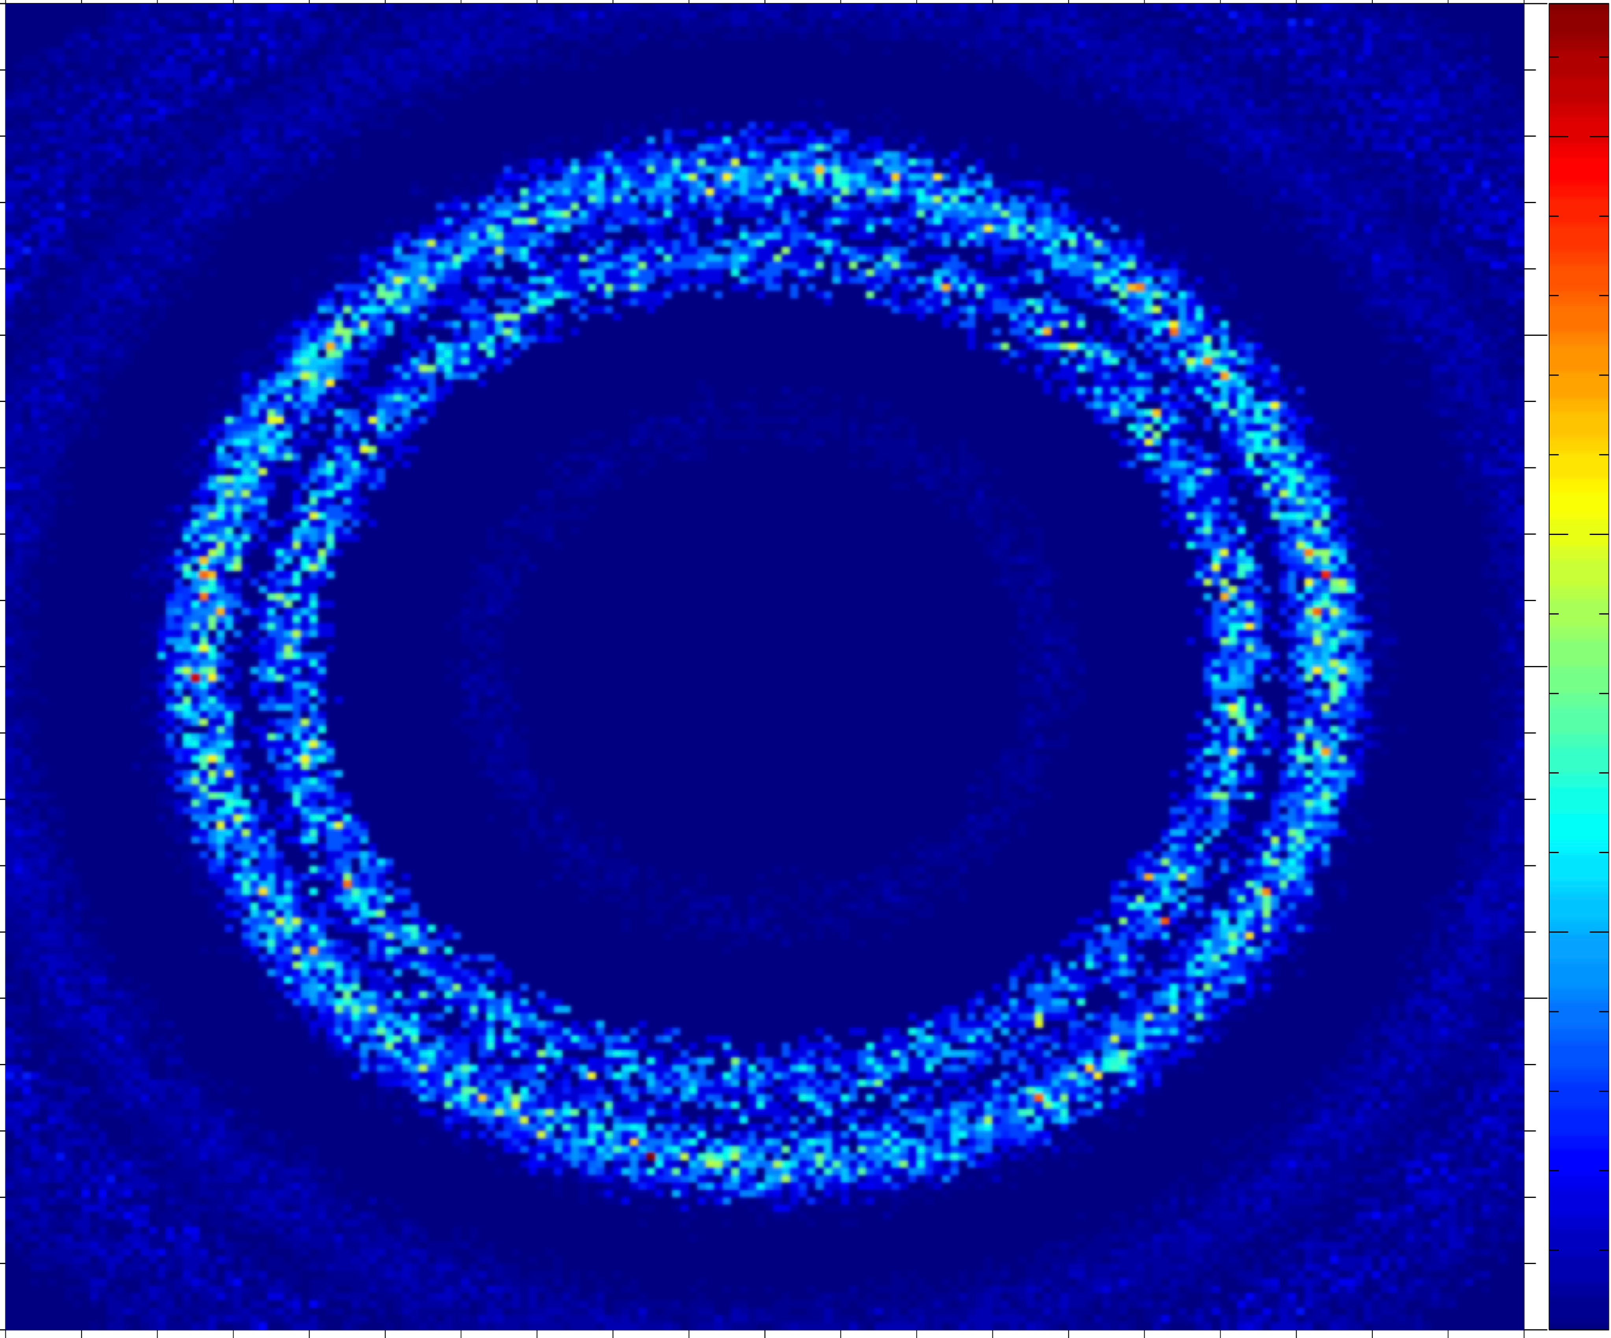

From single crystal / crystallites to powder….
Single crystal
Polycrystal with a little disorder, i.e. a preferred orientation, texture
Powder with complete disorder

Slide 4
Powder SX combination
Use a GROUP!
… but also allow reentry – How?
COMPONENT a1 = Arm()
AT(0,0,0) RELATIVE sample_pos
EXTEND
%{
sample_scatter=0;
%}
COMPONENT pow = PowderN( … )
AT(0,h/2,0) RELATIVE a1
GROUP sample
EXTEND
%{
if(SCATTERED) sample_scatter=1;
%}
COMPONENT sx = Single_crystal( …)
AT(0,-h/2,0) RELATIVE a1
GROUP sample
EXTEND
%{
if(SCATTERED) sample_scatter=1;
%}
COMPONENT a2 = Arm()
AT (0,0,0) RELATIVE a1
WHEN (scatter) JUMP a1
Powder
Single Crystal

Slide 5
Extending that idea
A polycrystal as many Single crystals
The idea: Cheat a single Single_crystal into believing it is many...

Slide 6
Apply translation

Slide 7
Single_crystal as polycrystal
Scattering events happen in the crystal neutron exits.
Apply translation

Slide 8
Single_crystal as polycrystal
Apply inverse translation
Scattering events happen in the crystal neutron exits.
Apply translation

Slide 9
Single_crystal as polycrystal
Apply inverse translation
Neutron may enter a new subcrystal...
Scattering events happen in the crystal neutron exits.
Apply translation

Slide 10
TOPAZ and SENJU
Take a look at a couple of “real” instrument simulations of Laue Cameras:
they both resides in GitHub under today / 3_Laue_diffractometers_TOPAZ\&SENJU/
1. SNS TOPAZ
2. J.PARC SENJU (aka. BL18)
Here you need to also copy a datafile for the J-PARC source “source_BL18.txt”
Surgeon General’s Warning: There are lots of COMPONENTS here

